Slide 1

CALCULUS
Chapter 4 INTEGRALS

Slide 2
4.1. Areas and Distance
4.2. The Define Integral
4.3. Evaluating Define Integrals
4.4. The Fundamental Theorem of Calculus
4.5. The Substitution Rule

Slide 3
4.1. Areas and Distances
In this section, we will learn that:
We get the same special type of limit in trying to find the area under a curve or a distance traveled.

Slide 4
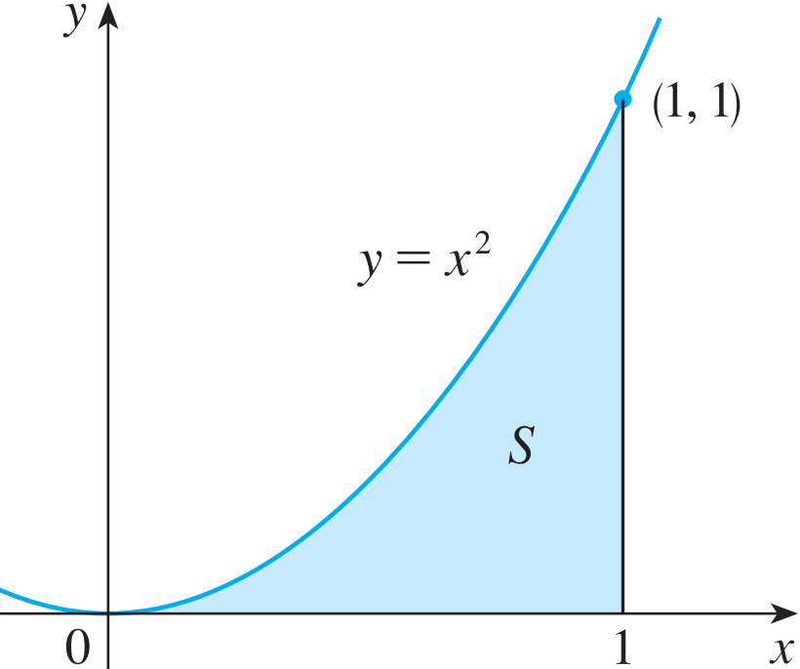
AREA PROBLEM
We begin by attempting to solve the area problem:
Find the area of the region S that lies under the curve y = f (x) from a to b ?

Slide 5
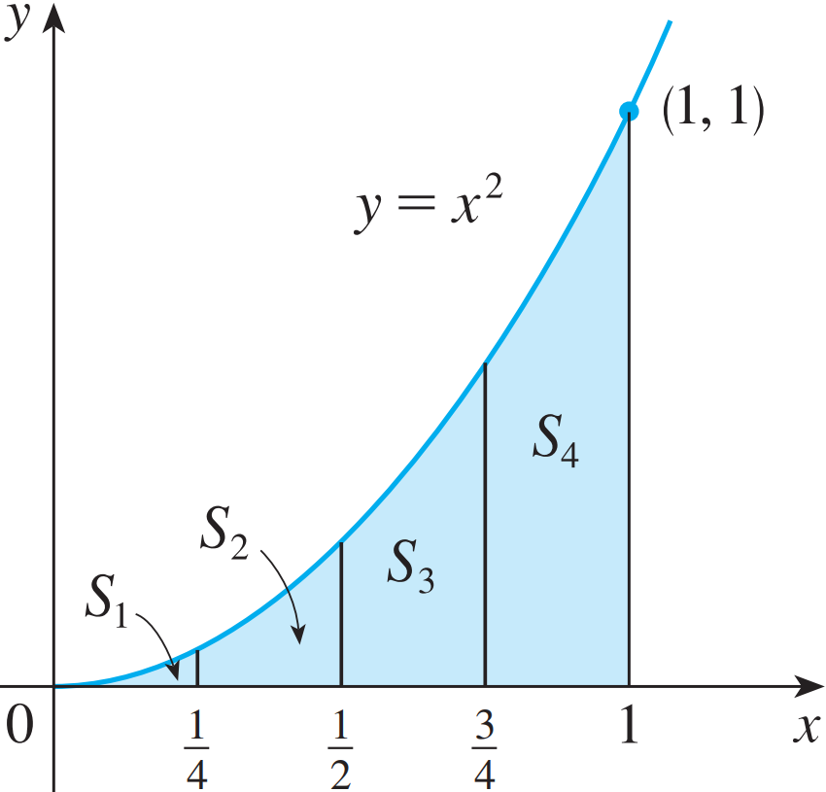
AREA PROBLEM
Example 1:
Suppose we divide S into four strips S₁, S₂, S₃, and S₄ by drawing the vertical lines x = ¼, x = ½, and x = ¾.

Slide 6
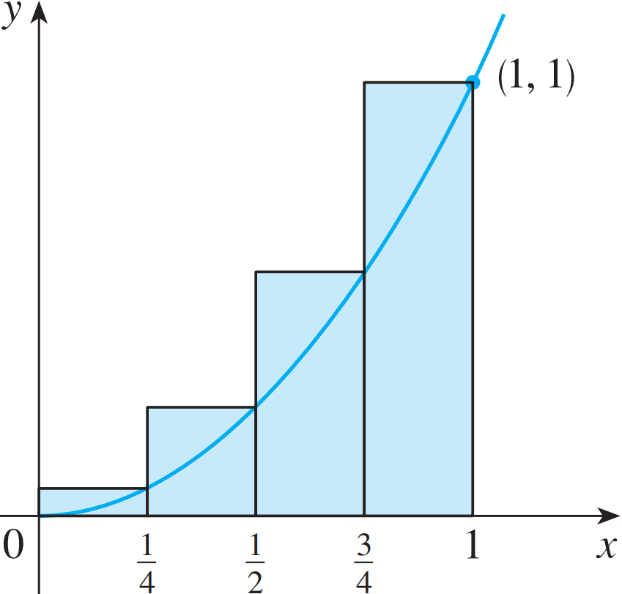
AREA PROBLEM
Example 1:
The heights of these rectangles are the values of the function f(x) = x² at the right endpoints of the subintervals [0, ¼], [¼, ½], [½, ¾], and [¾, 1].

Slide 7
AREA PROBLEM
Example 1:
Each rectangle has width ¼ and the heights are (¼)², (½)², (¾)², and 1².

Slide 8
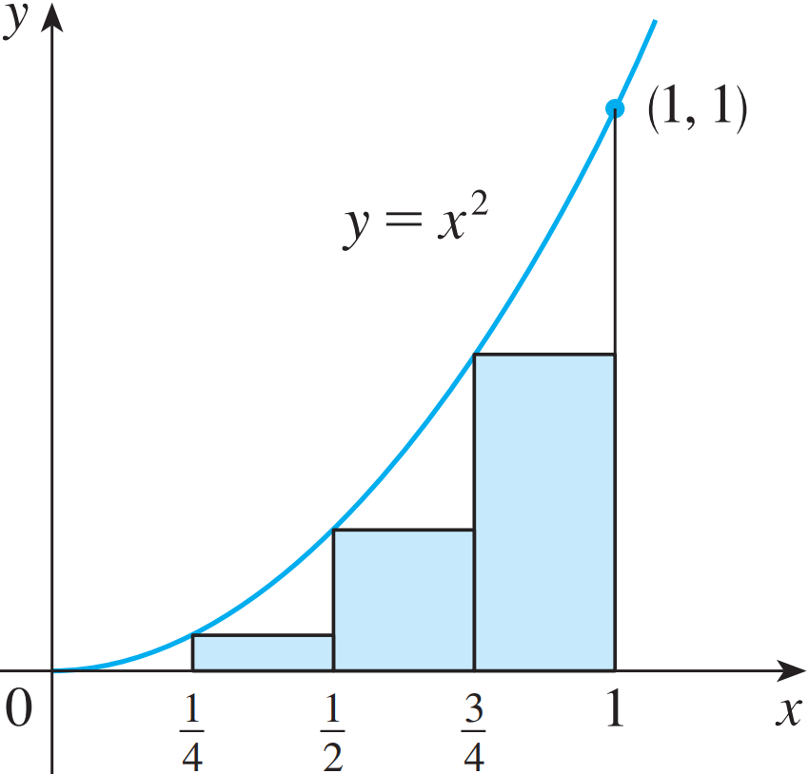
AREA PROBLEM
Example 1:
Here, the heights are the values of f at the left endpoints of the subintervals.

Slide 9
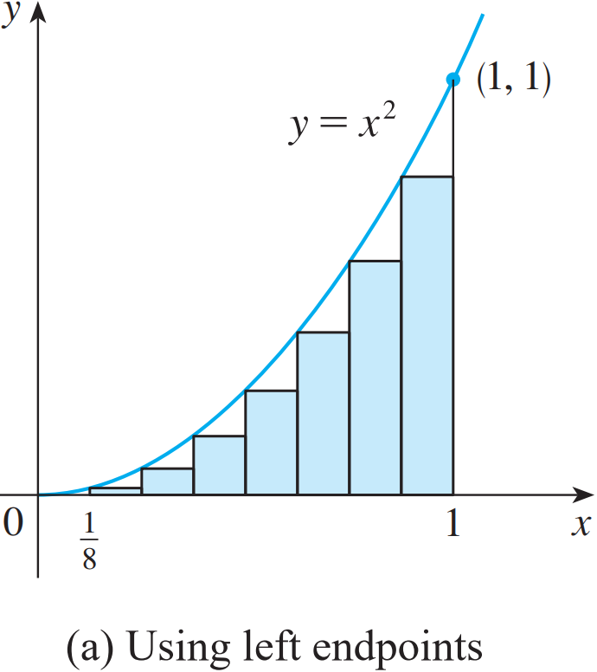
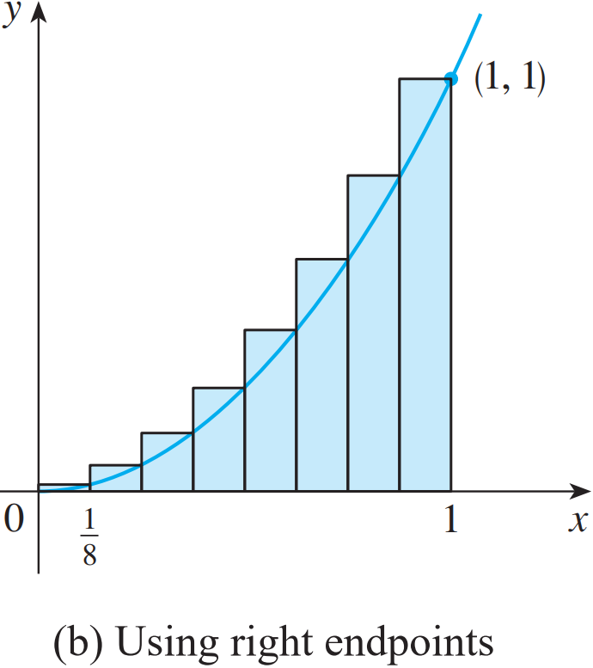
AREA PROBLEM
Example 1:
The figure shows what happens when we divide the region S into eight strips of equal width.
0.21875 < A < 0.46875

Slide 10
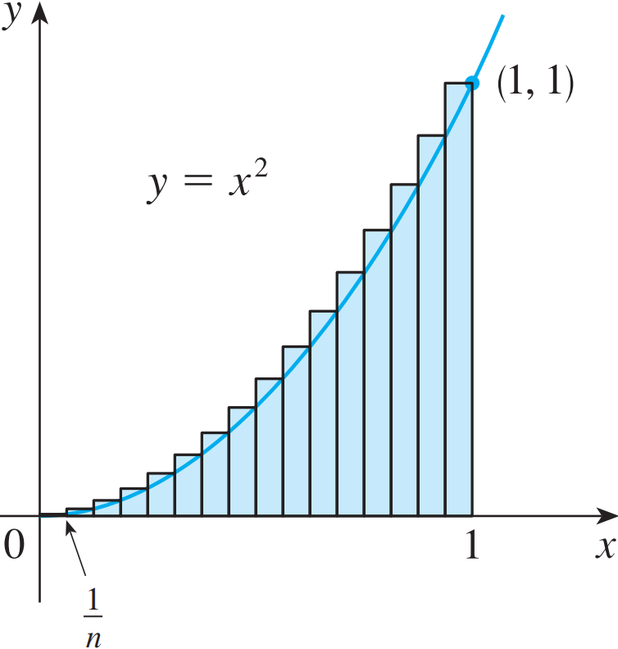
AREA PROBLEM
Example 2:
R_{n} is the sum of the areas of the n rectangles.
Each rectangle has width 1/n and the heights are the values of the function f(x) = x² at the points 1/n, 2/n, 3/n, …, n/n.
That is, the heights are (1/n)², (2/n)², (3/n)², …, (n/n)².

Slide 11
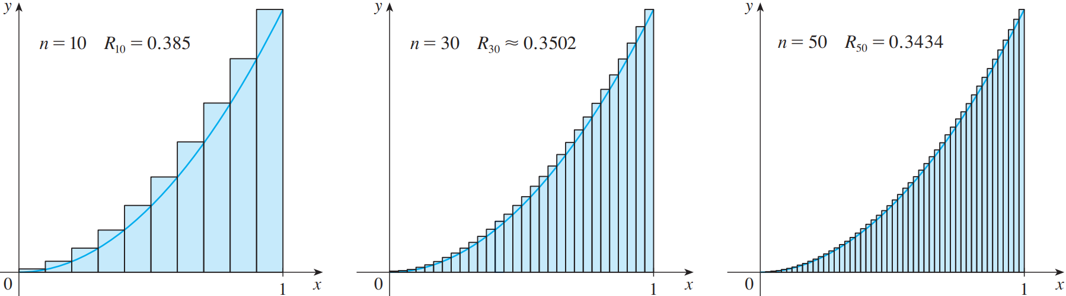
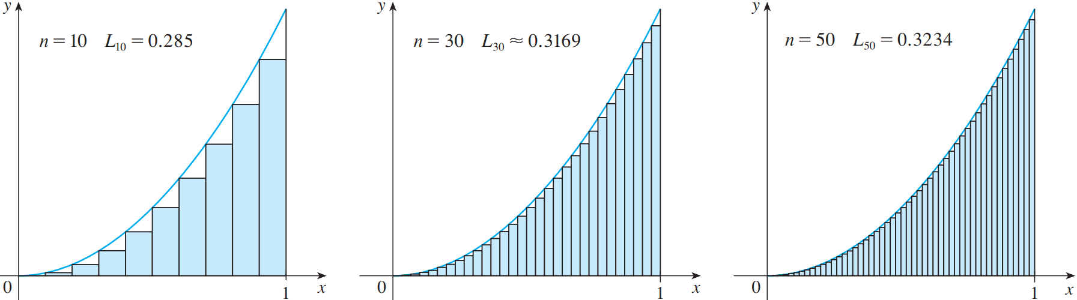
AREA PROBLEM
FIGURE 8: Right endpoints
produce upper sums because
ƒ(x) = x² is increasing.
FIGURE 9: Left endpoints produce lower sums because ƒ(x) = x² is increasing.

Slide 12
AREA PROBLEM
Example 2:
Thus,

Slide 13
AREA PROBLEM
Example 2:
Thus, we define the area A to be
the limit of the sums of the areas
of the approximating rectangles,
that is,

Slide 14
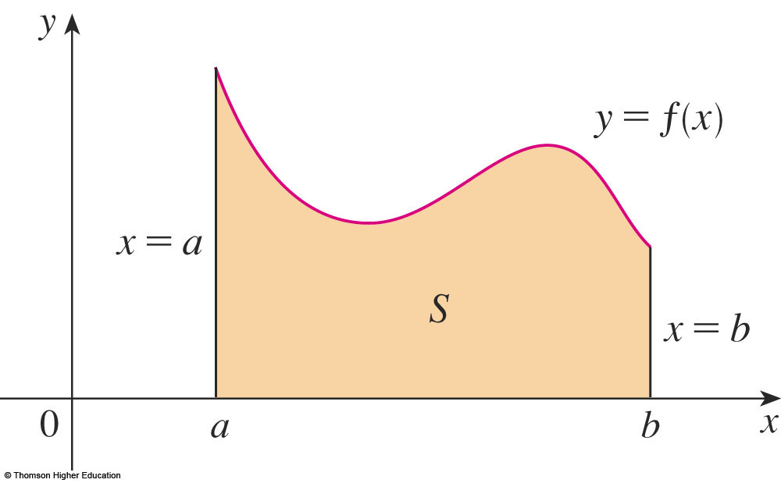
AREA PROBLEM
Let’s apply the idea of
Examples 1 and 2 to the
more general region S
of the earlier figure.

Slide 15
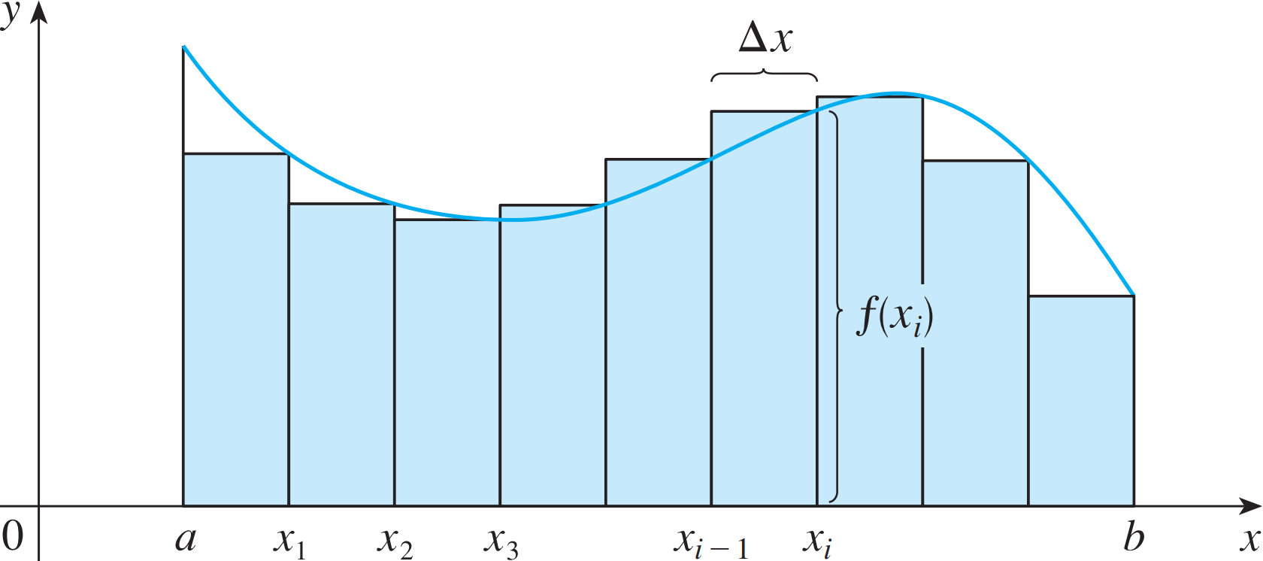
AREA PROBLEM
What we think of intuitively as the area of S is approximated by the sum of the areas of these rectangles:
R_{n} = f (x₁) ∆x + f (x₂) ∆x + … + f (x_{n}) ∆x

Slide 16
AREA PROBLEM
Definition.
The area A of the region S that lies under the graph of the continuous function f is the limit of the sum of the areas of approximating rectangles:

Slide 17
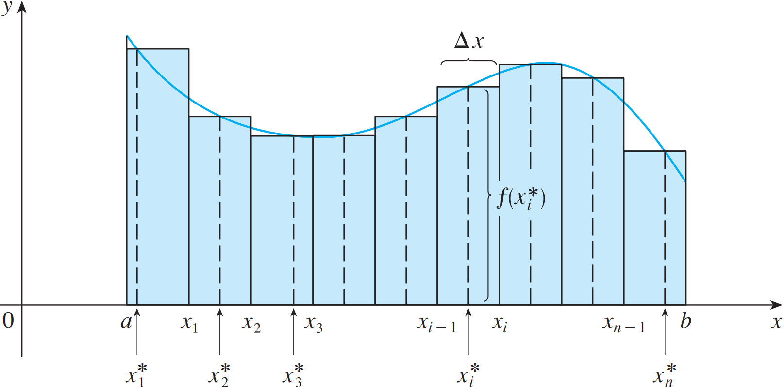
AREA PROBLEM
The figure shows approximating rectangles when the sample points are not chosen to be endpoints
x_{i}* in the i^{th} subinterval [x_{i - 1}, x_{i}] (the sample points)

Slide 18
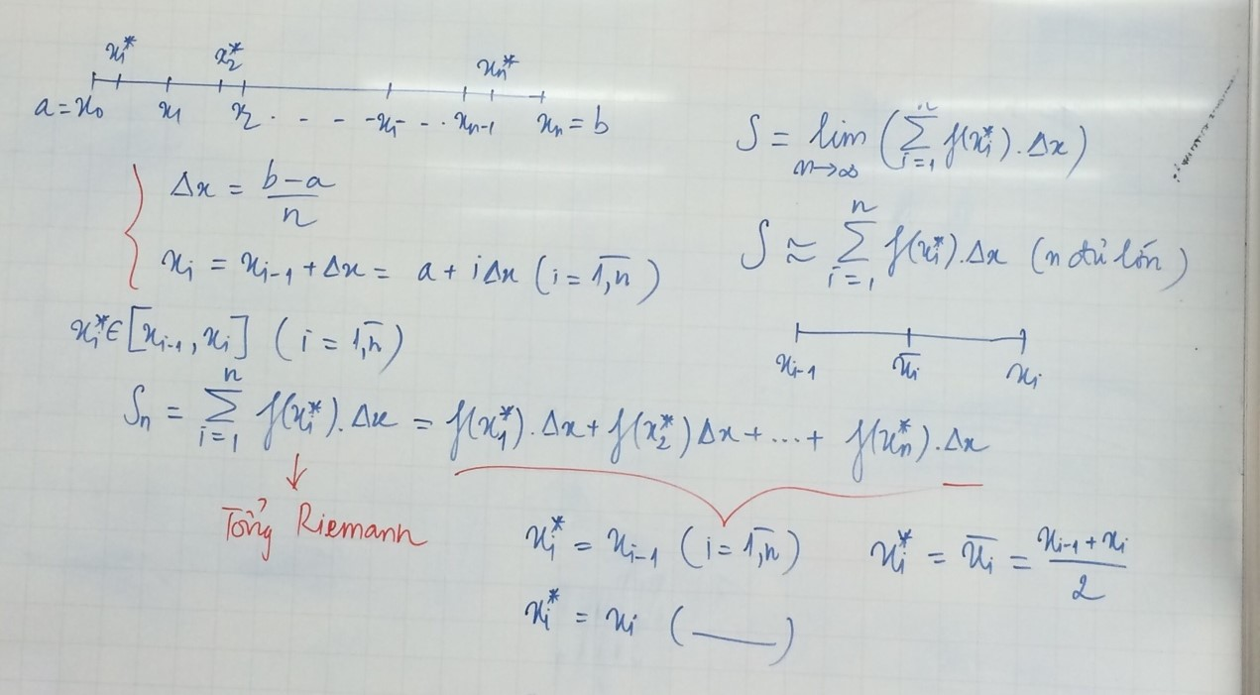

Slide 19
AREA PROBLEM
Hence,
The sum
is called a Riemann sum.

Slide 20
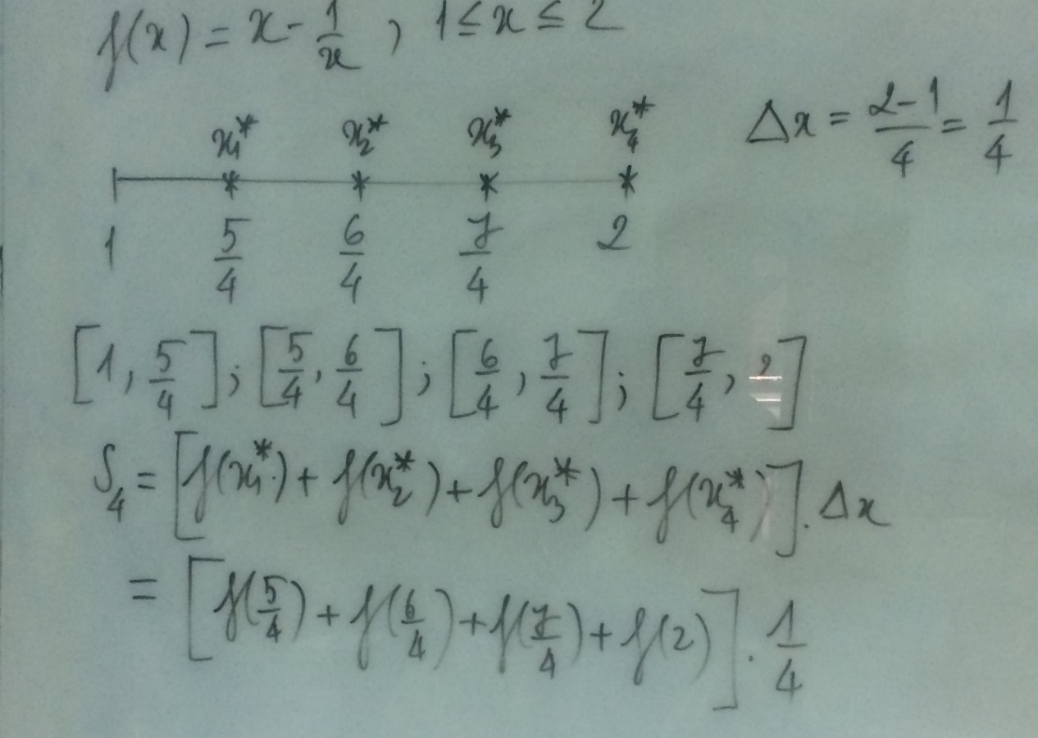
AREA PROBLEM
Example: Evaluating the Riemann sum of the function f (x) = x – 1/x (1 ≤ x ≤ 2) , with four subintervals. The sample points are the right endpoints.

Slide 21
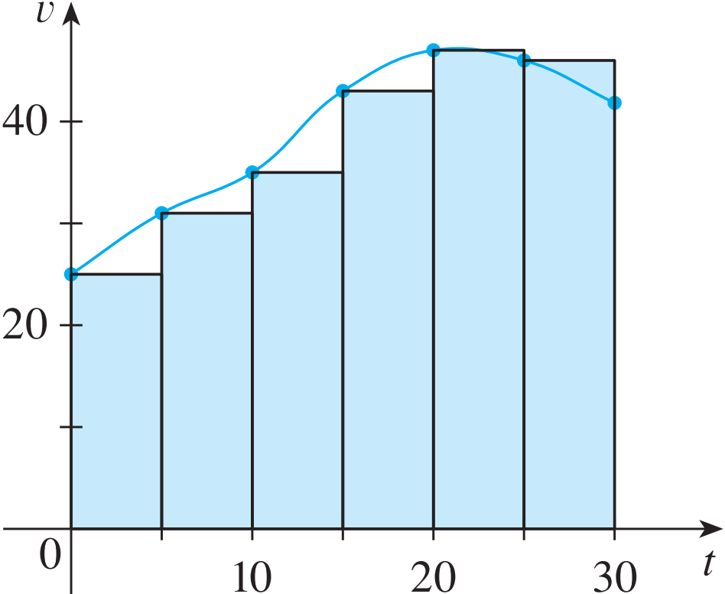
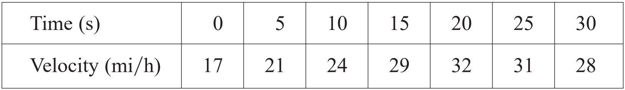
DISTANCE PROBLEM
Example 4/ page 291:
Suppose the odometer on our car is broken and we want to estimate the distance driven over a 30-second time interval. We take speedometer readings every five seconds and record them in the following table:
Notes:
Giả sử đồng hồ đo quãng đường trên ô tô của chúng ta bị hỏng và chúng ta muốn ước tính quãng đường đã đi trong khoảng thời gian 30 giây. Chúng tôi ghi chỉ số của đồng hồ tốc độ cứ sau 5 giây và ghi lại vào bảng sau:

Slide 22
4.2. The Definite Integral
In this section, we will learn about:
Integrals with limits that represent
a definite quantity.
Notes:
The precise definition of a definite integral.
The definition of an integrable function.
The concept of “area” and “signed area”.

Slide 23
DEFINITE INTEGRAL
If f is a function defined for a ≤ x ≤ b, we divide the interval [a, b] into n subintervals of equal width ∆x = (b – a)/n.
We let x₀(= a), x₁, x₂, …, x_{n}(= b) be the endpoints of these subintervals.
We let x₁*, x₂*,…., x_{n}* be any sample points in these subintervals, so x_{i}* lies in the i ^{th} subinterval.
Then, the definite integral of f from a to b is
provided that this limit exists.

Slide 24
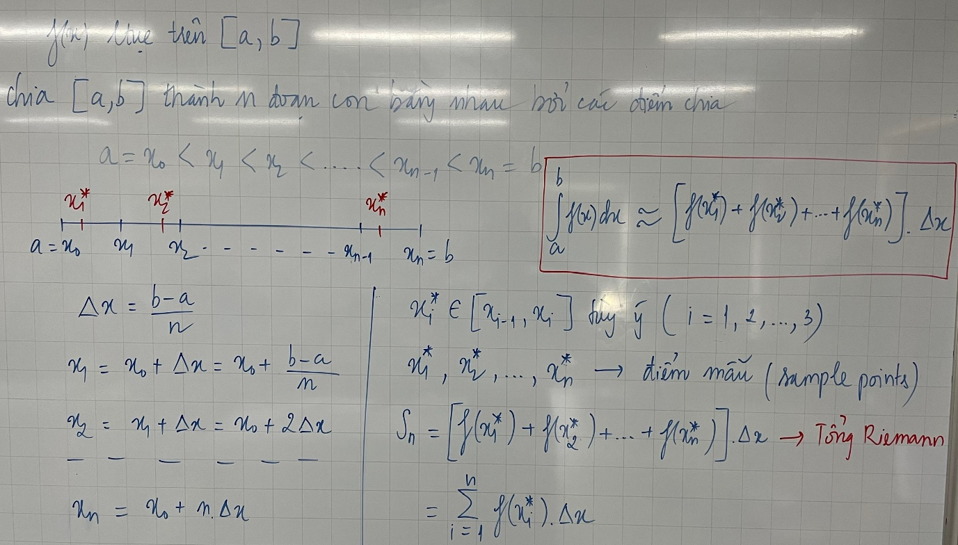

Slide 25
DEFINITE INTEGRAL
Then, the definite integral of f from a to b is
provided that this limit exists.
If it does exist, we say f is integrable on [a, b].
The symbol ∫ was introduced by Leibniz and is called an integral sign.

Slide 26
DEFINITE INTEGRAL
Note:
The definite integral is a number. It does not depend on x.
In fact, we could use any letter in place of x without changing the value of the integral:

Slide 27
DEFINITE INTEGRAL
From the definition of integral we can deduce:

Slide 28
INTEGRABLE FUNCTIONS
Theorem 1: If f is continuous on [a, b], then f is integrable on [a, b].
That is, the definite integral exists.
Theorem 2: If f is integrable on [a, b], then
where
From theorem 2:

Slide 29
INTEGRABLE FUNCTIONS
Theorem 1: If f is continuous on [a, b], then f is integrable on [a, b].
That is, the definite integral exists.
Theorem 2: If f is integrable on [a, b], then
where
From theorem 2:

Slide 30
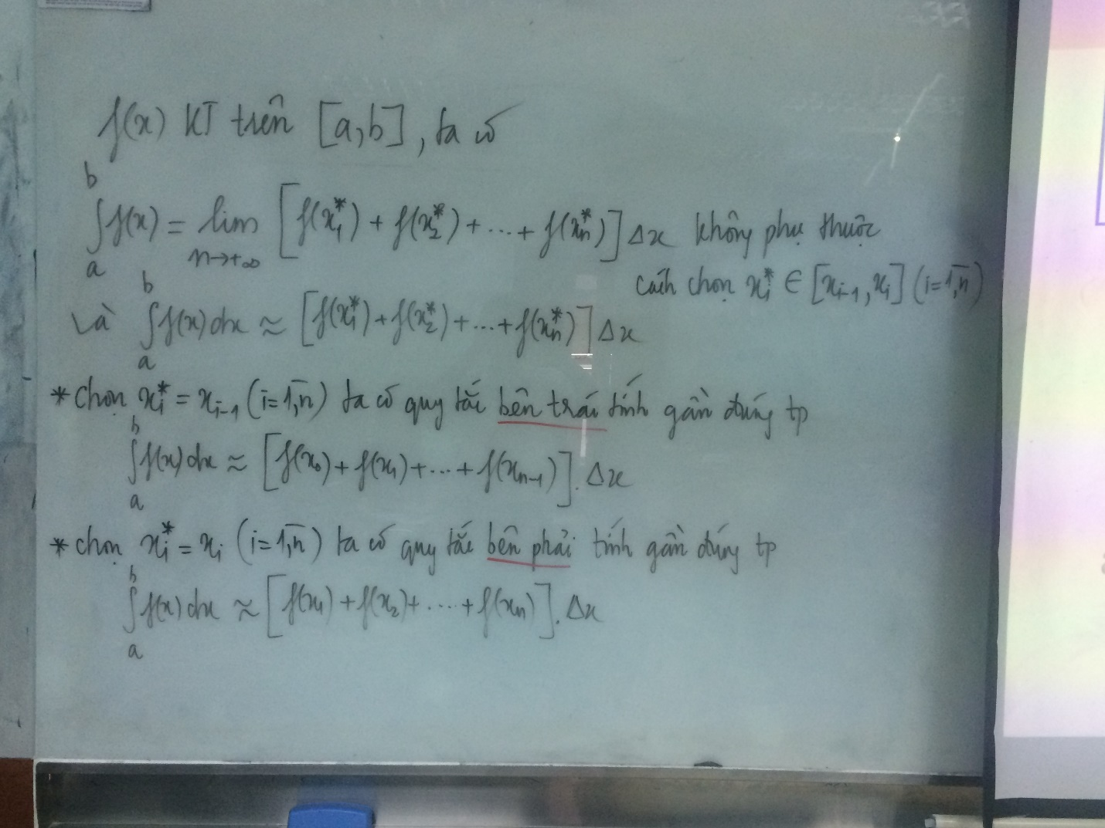

Slide 31
EVALUATING INTEGRALS
The following three equations give formulas for sums of powers of positive integers.

Slide 32
THE MIDPOINT RULE

Slide 33
THE MIDPOINT RULE

Slide 34
THE MIDPOINT RULE
Example:
Use the Midpoint Rule with n = 5 to approximate

Slide 35
PROPERTIES OF THE INTEGRAL
We assume f and g are continuous functions.

Slide 36
COMPARISON PROPERTIES OF THE INTEGRAL
These properties, in which we compare sizes of functions and sizes of integrals, are true only if a ≤ b.
Notes:
The geometric and comparison properties of definite integrals, developed as statements about area.

Slide 37
4.4. The Fundamental Theorem of Calculus
In this section, we will learn about:
The Fundamental Theorem of Calculus
and its significance.
Notes:
The precise definition of a definite integral.
The definition of an integrable function.
The concept of “area” and “signed area”.

Slide 38
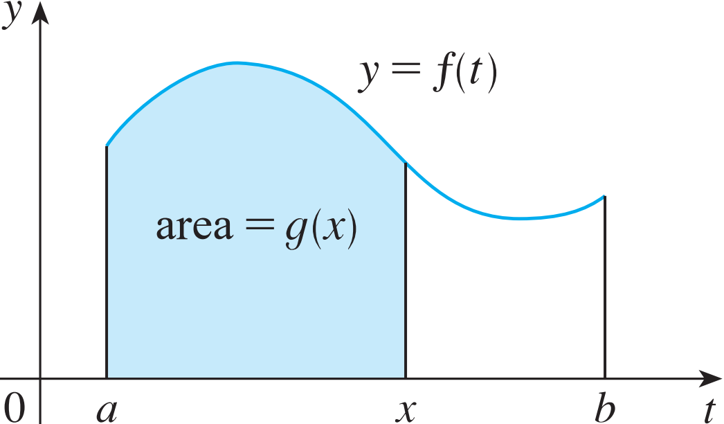
Fundamental Theorem of Calculus (FTC)
The first part of the FTC deals with functions defined by an equation of the form:
where f is a continuous function on [a, b] and x varies between a and b.

Slide 39
FTC
To see why this might be generally true, we consider a continuous function f with f(x) ≥ 0.
Then, can be interpreted as the area under the graph of f from a to x.

Slide 40
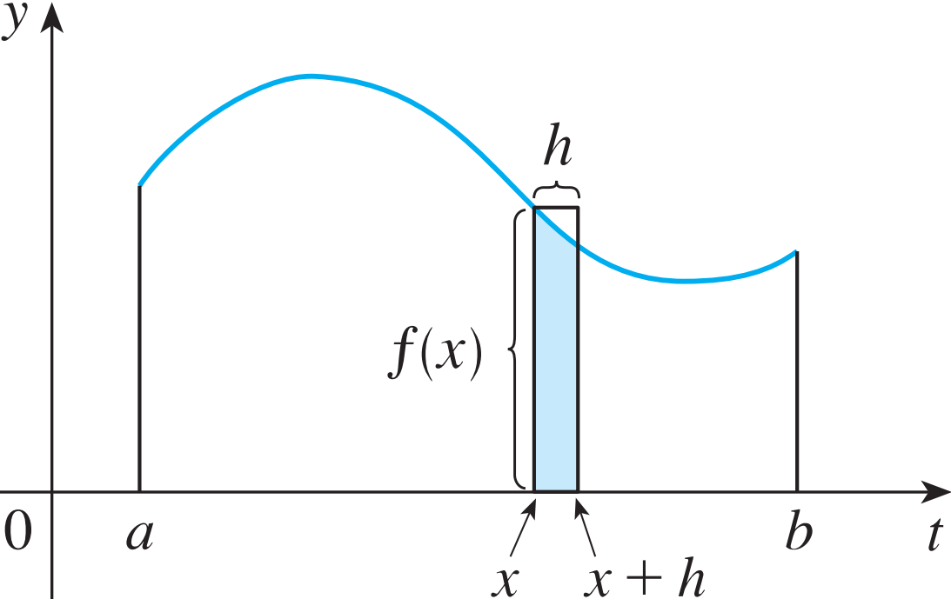
FTC
To compute g’(x) from the definition of derivative, we first observe that, for h > 0, g(x + h) – g(x) is obtained by subtracting areas.
It is the area under the graph of f from x to x + h (the blue area).

Slide 41
FTC
For small h, you can see that this area is approximately equal to the area of the rectangle with height f(x) and width h:
So,

Slide 42
FTC, part 1
Theorem (FTC 1): If f is continuous on [a, b], then the function g defined by
is continuous on [a, b] and differentiable on (a, b), and g’(x) = f(x).
Using Leibniz notation for derivatives, we can write the FTC1 as
when f is continuous.

Slide 43
FTC, part 1
Generalization.
Let u, v: [a, b] → [a, b] are continuous, differentiable functions on (a, b) and f: [a, b] → .
Given

Slide 44
FTC, part 1
Example: Given
Find ?

Slide 45
FTC, part 2
Theorem (FTC2). If f is continuous on [a, b], then
where F is any antiderivative of f, that is, a function such that F’ = f.

Slide 46
NET CHANGE THEOREM
So, we can reformulate as follows.
Theorem: The integral of a rate of change is the net change:

